Slide 1
Quality Assessment and Communicating Student Learning
Part 8

Slide 2
Included in Part 8
Unfolding the Process of Curriculum Design, Assessment and Communicating Student Learning
Learning Standards
Learning Progressions/Continuums & Proficiency Scales
Success Criteria
Notes:
Included in part 6:

Slide 3
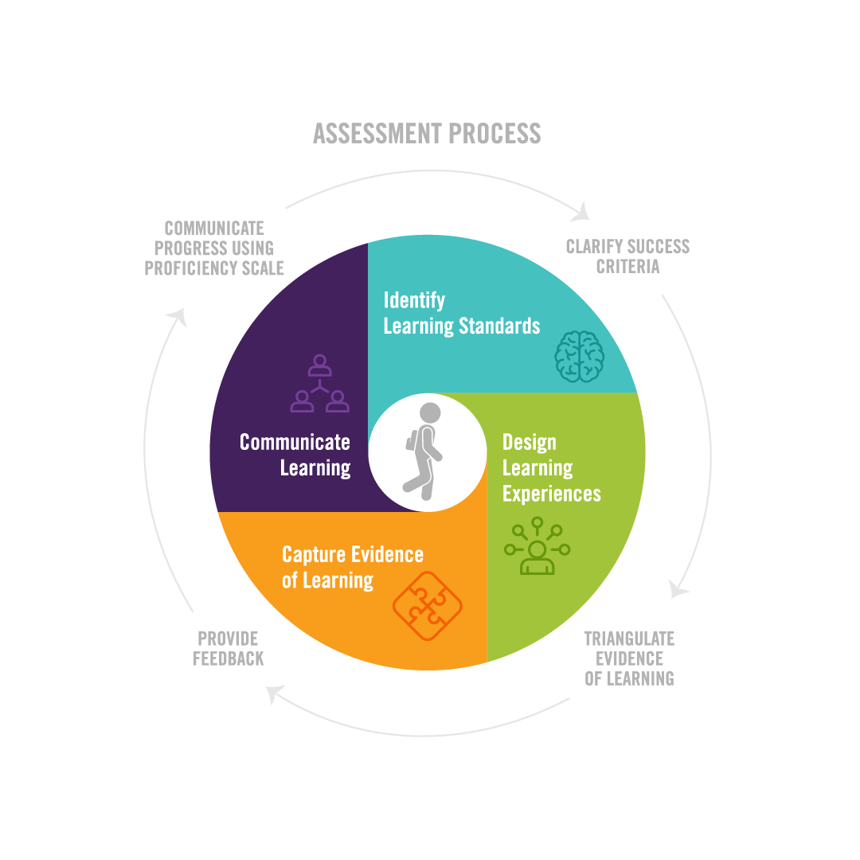
/CREATE PROFICIENCY SCALES
& REPORTING
Notes:
We have been referring to our infographic throughout our previous modules to build out a shared, conceptual understanding, videos 8 and 9 are designed to now take you through the process of curriculum design, instruction, assessment, and reporting. Throughout this process we will be pausing to give you time to engage in each part, which we will refer to as Action Phases. Please use the "Quality Assessment & CSL Process bundle" which is a resource in this module, as a tool to guide your thinking, planning, and design. We also encourage teachers to collaborate with other department members through this process which will allow you engage in deep thinking and calibrate to make your assessment more fair and consistent. We would like to acknowledge, that there are many different ways to engage in this process, we are offering just one approach. We also want to note that this process will take time, and perhaps many iterations as it unfolds for students. But we are certain that the more aligned, transparent and clear that it becomes for the teacher and students, the easier the entire assessment and communicating student learning process becomes. Our process always begins with the learners we have in front of us.

Slide 4
Notes:
And that we always approach our design, instruction and assessment process keeping the wellbeing and balanced development of the whole learner in mind. Our curriculum choices, as well as our classroom instruction, learning experiences and assessment processes take into account the identities, skills, interests, lived experiences, and needs of our learners and create opportunities for them to grow and develop from their strengths and gifts.

Slide 5
Assessment is personal, it's about growth, evolution, and human development
It is about who our students are, how they see themselves, and who they want to become
It supports and drives personalized learning
It is therefore a partnership and a relationship between students and teachers
It should be optimistic, and hold the promise of success
It should build confidence, develop efficacy, and inspire hope
Notes:
The process of education goes beyond knowledge acquisition; it encompasses understanding our students' identities, self-perceptions, and aspirations for personal growth. It serves as the foundation for personalized learning, tailoring educational experiences to meet individual needs and goals. Education is therefore, a collaborative journey, where students and teachers engage in a dynamic partnership, fostering a meaningful relationship that nurtures academic and personal development.
Assessment then, should be optimistic and hold the promise of success and the belief in students' potential. By this we don't mean we don't discuss the ways in which students need to grow and improve, it is the way we approach that conversation. Always starting with a strength, of what they CAN DO, and then work in the next steps.
By building confidence, fostering a sense of efficacy, and inspiring hope, education becomes a transformative force that empowers students to embrace their unique journeys and strive for their desired future selves.

Slide 6
/CREATE PROFICIENCY SCALES
& REPORTING
Notes:
Considering our learners, we now begin to design our curriculum, and this begins by identifying the learning standards from our currculum
these include the curricular and content standards what students will know, do, and understand.

Slide 7
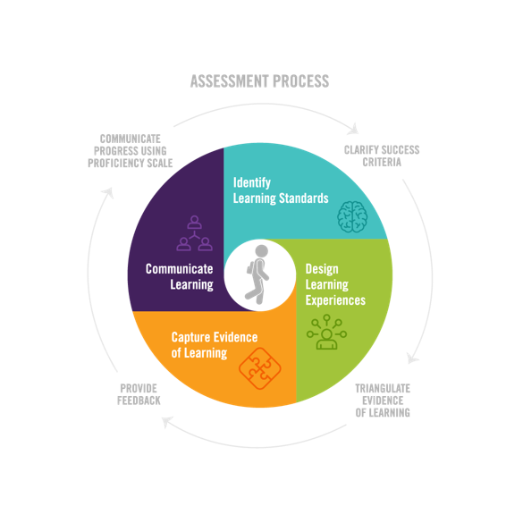
Learning Standards
In British Columbia, learning standards outline what schools are required to teach and what students are expected to learn.
Evaluation of student learning is based on the learning standards as set out in the 2016 Redesigned B.C. Curriculum.
Learning standards are explicit statements of what students are expected to be able to do (Curricular Competencies) and define what students should know (Content) in each area of learning.
Based on learning standards, teachers, set strengths-based, observable, and developmentally appropriate criteria with which to evaluate students’ learning. These criteria form the basis for evaluating and communicating student learning.
Notes:
In British Columbia, evaluation of student learning is based on the learning standards set out in the provincial curriculum. Learning standards are explicit statements that outline what students are expected to be able to do (Curricular Competencies) and what they should know (Content) in each area of learning. These standards define what schools are required to teach and what students are expected to learn. Based on the learning standards, teachers (and sometimes students) set strengths-based, observable, and developmentally appropriate criteria with which to evaluate students' learning. These criteria form the basis for evaluating and communicating student learning. By using these criteria, educators can ensure that students are meeting the expected standards of learning and can provide feedback that helps students to identify areas for growth and improvement. Ultimately, by basing evaluation on the learning standards set out in the B.C. curriculum, educators can ensure that students are receiving a high-quality education that prepares them for success in the future.

Slide 8
Big Ideas (Understand):
Concepts
Theories
Principles
Generalizations
Patterns
Transcending time
Transferable to new and different contexts
“Ah ha” moments
Curricular Competencies (Do):
Skills
Strategies
Processes
Applications
Dispositions
Content (Know):
Vocabulary
Facts
Topics
Concepts
Disciplinary Knowledge
Notes:
Our curriculum which is based on the Know, Understand, and Do (KDU) model, outlines what the teacher will teach and what the students will learn. The spirit of our currculum however, allows for flexibility and choice for the teacher to:
Allow for personalization to the unique needs of their students
Cross curricular connections
Opportunity for inquiry based learning
The ability to integrate local context
Emphasize the development of competencies
Diversity of assessment
Teacher professional autonomy
A shift to standards based assessment requires teachers to make decisions about which learning standards they would like to formally assess and track the growth over time, as not all bullets require formal reporting. Once a teacher identifies these learning standards, they begin to break down the standard into smaller parts for focused learning goals.

Slide 9
From a Learning Standard to a Learning Goal
Learning Standard
Language from the curriculum that the teacher understands
Learning Goal
Brings together a few of the learning standards in student friendly language
Communicates to students not only what they are expected to learn but how these different pieces of knowledge/competencies are interconnected and for what purpose
“Students can reach any target that they know about and that holds still for them.”
Rick Stiggins, 2006
Notes:
There is often confusion and the terms learning standard and learning goal are used interchangeably, when in fact they are different.
Learning standards are from the curriculum and written in pedagogical language that usually only makes sense to teachers and educators. They are broad whereas learning goals put the intended learning into context.
Learning goals are written in student friendly language and may include a few learning standards and communicate to students not only what they are expected to learn but how these different pieces of knowledge/competencies are interconnected and for what purpose.

Slide 10
Learning Goals:
Provides clarity and focus
Ensures teachers have clear understanding of what students need to learn and achieve
Guides planning and assessment
Sets specific targets for student learning
Helps monitor and track student progress
Notes:
Provides clarity and focus
Ensures teachers have clear understanding of what students need to learn and achieve
Guides planning and assessment
Sets specific targets for student learning
Helps monitor and track student progress

Slide 11
The steps to writing a learning goal...
Read and understand the learning standard: What should students know and be able to do?
Identify key components: Break down the standard into smaller parts for focused goals.
Make the goal clear and measurable: Use specific action verbs to describe what students will achieve.
Consider student needs: Consider the learning continuum/progression to support ALL learners
Communicate the goal to students: Ensure that the learning goal is written in student-friendly accessible language.
Notes:
Start by breaking down the learning standard you are working with.
Consider the desired outcome: What should students be able to do or understand after achieving the learning goal?
Think about the skills, knowledge, or competencies that students should acquire.
Make the learning goal specific and measurable: Craft a clear and concise statement that describes what students will achieve. Use action verbs that indicate observable behaviors or actions. Ensure that the learning goal is measurable so that you can assess and track students' progress.
Consider the learning continuum/progression to support ALL learners. This can be done when you get to the stage where you clarify the proficiency scale.
Communicate the goal to students: Ensure that the learning goal is written in student-friendly accessible language.

Slide 12
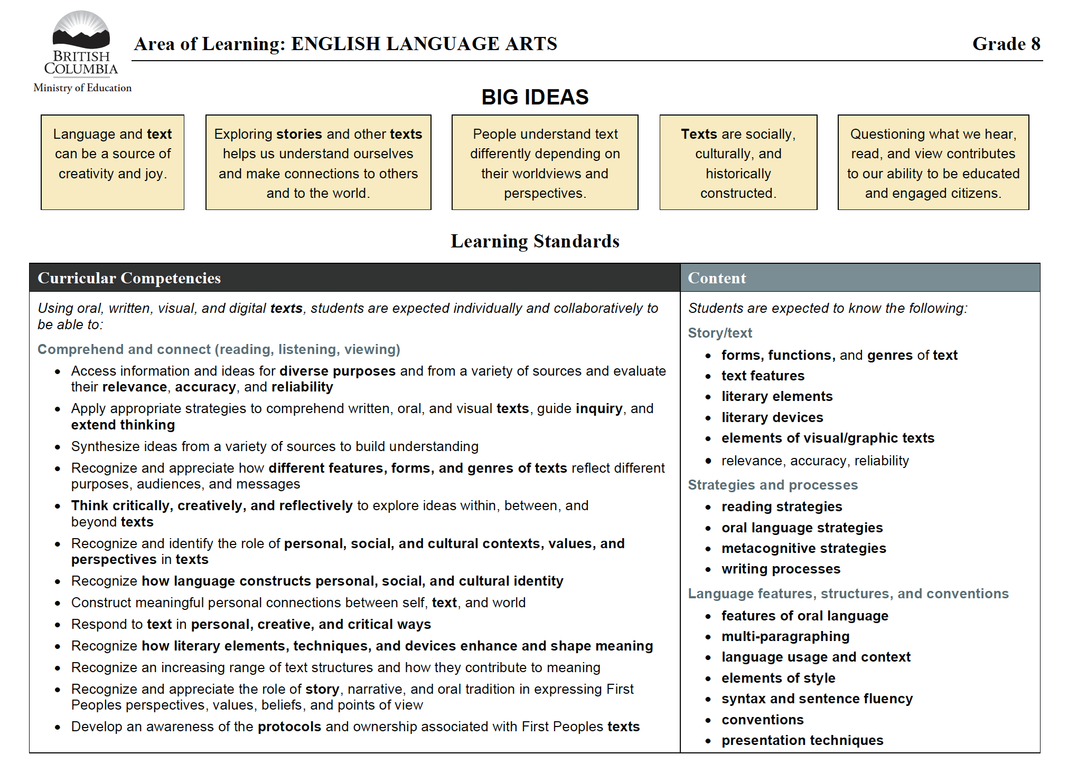
Identifying Learning Standards:
What knowledge, skills and processes are students to learn for ?
Notes:
To begin this process, ask yourself ‘ what knowledge, skills and processes are students to learn? In this example we have picked a number of learning standards both from the curricular competencies and the content standards that fit together for the development of the communication competency that we identify as one we would like to capture growth over time, and formally report.

Slide 13
What is the goal of the learning?
What do you want students to know, remember, and develop for the long term?
Learning Goal:
I can communicate my knowledge and understandings of the big ideas, concepts, and content of this unit with precision of language, fluency and accuracy (Speaking, Writing, Visual, Digital).
Notes:
The next step is to identify what is the goal of the learning? What do you want students to know and remember, and develop for the long term? Teachers articulate this learning in student friendly language based on how they contextualize the learning for their students. In this example, we have taken many curricular and content learning goals, and put them together as a process for effectively communicating ideas and understandings. With this, we intend to combine the learning standards, turn them into learning goals, and then give students multiple opportunities to practice and demonstrate growth over time. Instead of assessing and reporting these separately, we simplify what we are tracking and reporting to keep the assessment process clear, and easy to understand for students, families and caregivers. In some cases or areas of learning, teachers may not combine multiple learning standards into one learning goal, but instead take a standard and break it into multiple learning goals if the teacher wants to track the different nuances of the learning standard and that may make the assessment process and communication of learning more clear for students, parents, and caregivers. The goal here is to think about how you contextualize the learning for the standards, and what you want to track and report.

Slide 14
PAUSE
ACTION 1
Please use the 'Quality Assessment and Communicating Student Learning Process' bundle as you engage in the action phase of this work.
Please refer to the BC Curriculum, for your area of learning, and a grade level.
Identify learning standards that you would like students to develop, track growth over time, and communicate progress formally.
Which learning standards can either be grouped together, or split apart to support students in developing their skills, knowledge and competencies?
Write these as student friendly learning goals to communicate to students not only what they are expected to learn, but how these different pieces of knowledge/competencies are interconnected and for what purpose
Notes:
Please pause here and use the "Quality Assessment and CSL Planning Template" and engage in Action 1.

Slide 15
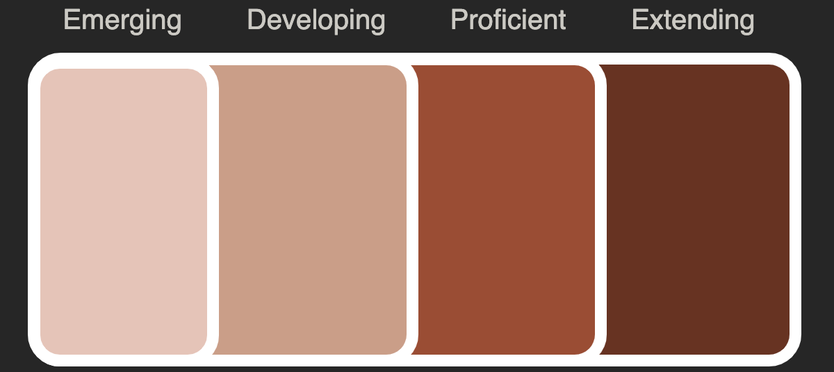
/CREATE PROFICIENCY SCALES
& REPORTING
Notes:
As an educator, you know that skills grow and continue to improve over time and with practice. When students see that learning is on a continuum, they are more likely to stick with it even when it gets difficult. We are required to use the provincial ministry scale to formally report and communicate student learning from K-9,and although in grades 10-12 we are required to report using letter grades and percentages, providing the learning progression within a proficiency scale, will give students specific information about where they are, and what they need to do next to develop their skills and knowledge base.
Each place on the learning progression or scale represents a target for all your students at any given time. Therefore, it is important to clearly establish what learning looks like at each level, rather than focusing on what it doesn't look like. This approach helps to ensure that students understand what is expected of them and can see a clear path for growth and development. Ultimately, the goal is for students to see learning as a progression rather than something that they either "get" or "don't get." By emphasizing the importance of growth and development, and by providing students with clear targets and expectations, you can help to foster a growth mindset and encourage students to embrace challenges and persist in the face of difficulties.

Slide 16
RUBRICS, LEARNING PROGRESSIONS, PROFICIENCY SCALES All assessment tools that are used to evaluate & measure student learning, but they differ in their purpose and structure.
RUBRICS
FOCUSEs ON THE LEVEL OF QUALITY THAT WILL BE USED TO EVALUATE STUDENT WORK
Purpose to assess at end of learning period (summative)
Identify success criteria at varying levels of achievement
Are for assessing specific assignments/tasks/learning experiences
The success criteria for proficient is written in positive language, and then the emerging and developing categories are deficits of the success criteria
Learning Continuums/Progressions
FOCUSEs ON THE WHAT THE STEPS IN LEARNING LOOK LIKE AS STUDENTS DEVELOP THEIR UNDERTANDING OF SKILLS/COMPETENCIES AND CONTENT KNOWLEDGE
describe continuum of learning: describe what achievement looks like at varying levels of complexity
help identify where students are in their learning, and where they may need additional support
provide feedback (formative assessment processes)
help determine level of achievement at a given point in time (summative assessment)
guide and scaffold instruction
Proficiency scale
Focuses on Describing WHAT THE STEPS IN LEARNING LOOK LIKE AS STUDENTS' PROGRESS IN THEIR UNDERTANDING and demonstration OF SKILLS/COMPETENCIES AND CONTENT KNOWLEDGE, provides a clear framework to guide instruction, assessment, and feedback for both students & teachers
Purpose is to measure student learning over time and determine whether students are meeting specific learning standards/goals
Provide a clear picture or description of what students should know and be able to do at each level of proficiency of a particular competency/skill, concept, knowledge base
Help teachers assess student achievement and to provide targeted feedback to identify strengths and next steps to support further growth and improvement, also guides the teacher's next steps and strategies to scaffold instruction
Students can track their own progress & identify strengths
RUBRICS
Notes:
Before we begin creating our proficiency scales, it is important to distinguish between the following:
Continuums/Progressions/ or Scales look similar to rubrics but they are different
Most scales or rubrics are single-point posing as four. Their authors describe Proficient, that’s it. The text for Proficient is copied and pasted to the Emerging and Developing (or Novice and Apprentice) columns. Then, words such as support, some, and seldom are added. Errors, minor (Developing) and major (Emerging), too. These phrases convey to students how they come up short of Proficient; they do not tell students what they know and can do at the Emerging and Developing levels.
Proficency scales can help teachers identify areas of strength where students are struggling and develop strategies to address these areas that require growth. Students can also use proficiency scales to track their own progress and identify areas where they need to focus their efforts.
Overall, a proficiency scale is a tool that focuses on describing the levels of understanding or performance for a particular skill or concept, and provides a clear framework to guide instruction, assessment, and feedback for both teachers and students.

Slide 17
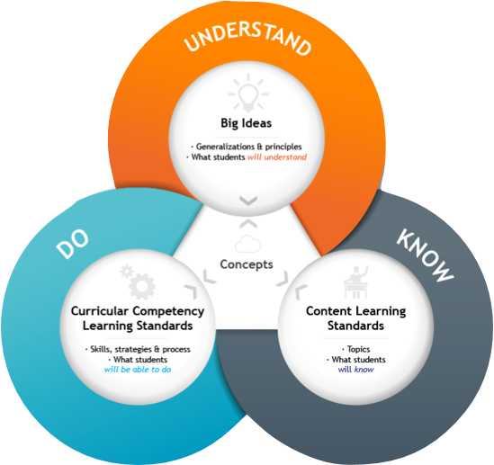
PROFICIENCY – What students know and what they can do
LEARNING STANDARD/GOAL
EMERGING
EMERGING
EMERGING
DEVELOPING
PROFICIENT
EXTENDING
Notes:
Once we have identified the learning standard/goal that we are focusing on, we need to unpack what students should know and be able to do. The different levels of proficiency are not stand alone, instead the skills and content knowledge build upon one another. Although proficiency scales are illustrated as linear, we found this model of the scale and accompanying concepts designed by Numeracy Helping Teachers Marc Garneau and Chris Hunter, helpful in making meaning of the proficiency scale.

Slide 18
PROFICIENCY – What students know and what they can do
LEARNING STANDARD/GOAL
EMERGING
EMERGING
EMERGING
DEVELOPING
PROFICIENT
EXTENDING
Progressive & Additive
Positive​
Descriptive​
Notes:
The proficiency scale is descriptive in that it describes what students should do and know at each level of the scale. It is also progressive and additive, which emphasize the concept of expanding and growing. As students move through the different levels of proficiency, they maintain the skills and content knowledge from previous levels, while developing and enhancing new skills and deeper level of content knowledge. So in other words, the skills and content knowledge that is developed in the emerging column is built upon in the developing column, with new skills and knowledge added, and then those are built upon in the proficient column with new skills and knowledge, and so on.
Proficiency scales are also Positive. When we are building out the scale, we consider the learning progression for the Learning standard. We start with the success criteria in proficient. The emerging and developing are not deficits of the proficient column, they are the building blocks of the proficient criteria, therefore it is important to be Descriptive and outline what students know and can do in each level of the scale.

Slide 19
PROFICIENCY – What students know and what they can do
LEARNING STANDARD/GOAL
EMERGING
EMERGING
EMERGING
DEVELOPING
PROFICIENT
EXTENDING
Progressive & Additive
Positive​
Descriptive​
Notes:
Some times, proficiency scales and or rubrics are designed by articulating the success criteria in the proficient column, and then words such as support, some, and seldom are added to give the impression of differentiation between levels. However, this approach has a critical shortcoming; it fails to inform students about their strengths, what they know and can do at each level and what their next steps are for growth and improvement. Instead this only conveys where students fall short of the Proficient level, and provides minimal guidance to students on how they can improve, leaving them without a clear path forward to reach their learning goals. As such, it is imperative to develop rubrics and proficiency scales that are positive, progressive and additive, and accurately reflect students' abilities at different levels, providing meaningful feedback that supports their growth and development.

Slide 20
Success Criteria WHAT DOES IT LOOK LIKE TO DEMONSTRATE PROFICIENCY OF THE LEARNING standard/GOAL?
Outlines what a student should be able to do in order to demonstrate proficiency of a learning goal/learning standard
Observable, actionable, measurable
Co-constructing success criteria brings students into the learning process, and increases ownership of learning
Opens up the possibilities to capture evidence of learning
Feedback and assessment directly connected to success criteria
Should be expressed in language that students can understand and use.
Notes:
To begin the process of clarifying the proficiency scale, we start with the proficient column and the corresponding success criteria for the learning goal.
Success criteria is a teaching and learning tool that students and teachers can use to monitor growth and progress. If we want our students to be assessment capable, they need to develop a concept of what it looks like to achieve their learning goals. When they have this information they can use it to monitor their learning, decide where to focus their efforts and make decisions about next steps. Teachers also use this information to design what they need to explicitly teach and use the formative assessment information to make decisions about what learning experiences they will design, monitor student learning and inform their next steps. With relevant and accurate criteria, learners are empowered to make decisions to move their learning forward.
Accessible Learning Goals and Success Criteria enables students to participate in and contribute to the learning community by evaluating their own and their peers’ learning. When students internalize Learning Goals and Success Criteria, this also helps them make meaning of challenging content. A clear sense of what the goal is and what it will look like as they move towards that goal can act like a cognitive lighthouse, a feature of the cognitive landscape with which students can use to organize and orient their learning.
Success Criteria:
Outlines what a student should be able to do in order to demonstrate proficiency of a learning goal/learning standard
Observable, actionable, measurable
Opens up the possibilities to capture evidence of learning (triangulation)
Feedback and assessment is directly connected to success criteria
Although you pre-consider the success criteria during your curriculum design, ideally you want to go through the process of Co-constructing success criteria in order to bring students into the learning process, and this increases ownership of learning. There may be times when you do not go through the process of co-constructing, however it is still important to work through the criteria with students so that they have a shared understanding.

Slide 21
What does is look like to demonstrate proficiency of the learning goal?
What is the success criteria?
Learning Goal: I can communicate my knowledge and understandings of the big ideas, concepts, and content of this unit with precision of language, fluency and accuracy (Speaking, Writing, Visual, Digital).
Content
Demonstrate a critical understanding of the big ideas, and key concepts explored in this unit
Support my ideas with evidence, examples, and explanations
Demonstrate my ability to connect the big ideas of the unit to background knowledge, self, texts and world
Precision of Language
Use specific and descriptive language to convey ideas clearly.
Use precise vocabulary and terminology within context
Fluency
Communicate in a clear and organized manner that is easy to follow.
Use transitions to connect ideas and create a smooth flow.
Use language/visuals/digital tools and technology to communicate my ideas in more creative ways to maintain interest and engagement
Use appropriate tone and voice for the intended audience and purpose
Accuracy
Use reliable sources to support arguments.
Fact-check information before communicating
Edit and revise work for errors and inconsistencies.
Use appropriate conventions for writing, speaking, visual, and/or digital communication
Notes:
To revisit our previous example of the ELA learning goal, we refer to what students need to know and do in order to demonstrate proficiency of the learning goal. We always begin by clarifying the success criteria in the proficient column.

Slide 22
2 (This informs planning & teaching). | 3 (Skills & knowledge required to meet the learning goal). | 1 (Level of proficiency students are working towards). | 4. (Going further/deeper)
Emerging (Pre-assessment, background knowledge, and access points) What foundational skills, vocabulary, concepts, etc. do students need to know and demonstrate in order to access the learning goal? | Developing (Exploring & Practicing; (Sub-skills of learning goal) What skills and knowledge do students need to develop and practice in order to move towards proficiency? | Proficiency (Success Criteria) (Success criteria for the learning standard/goal) How will students know that they have achieved proficiency in the learning goal? | Extending (Increasing sophistication and depth; Advanced knowledge of learning standard/goal, skills) What might students do to refine skills, increase sophistication, and deepen understanding?
Notes:
Once we've identified the success criteria for Proficient, we continue the process of defining the rest of the proficiency scale. After proficient, the next step is to define the Emerging column. This column includes the foundational vocabulary, concepts, knowledge and skills that students need to develop in order to access the learning goal. These are the fundamental building blocks of the learning goal. This could be a crucial access point for our learners who may be at the very early stages of this learning goal.
Next we clarify the Developing stage. In this stage we explore, learn and develop the sub-skills that will move us towards proficiency.
Finally, we elaborate the Extending level. Students who have demonstrated proficiency of the learning goal are challenged to increase their sophistication and refinement of skills and depth of knowledge of the learning goal. This criteria may be clearly defined on the scale, or may differ from student to student, so a teacher may want to collaborate with the student to discuss what they would be working on.

Slide 23
ELA 8 & 9- Proficiency Scale
I can communicate my knowledge and understandings of the big ideas, concepts, and content of this unit with precision of language, fluency and accuracy (Speaking, Writing, Visual, Digital).
Emerging -I am beginning to... | Developing- I am developing the ability to... | Proficient- I can... | Extending- I am..
Content Identify key ideas and use subject specific vocabulary Identify evidence to support key ideas Precision of Language Develop a varied vocabulary with the use or support of a word bank Fluency Organize my ideas using an outline Develop clarity in my communication by using proper sentence structure/visuals/digital tools Consider my audience and use appropriate language (formal, casual, academic). Accuracy Use the sources used in class in a logical and clear manner Edit and revise for errors | Content Organize and explain key ideas using subject specific vocabulary Support the key ideas with evidence and examples Precision of Language Use specific and descriptive language Use appropriate vocabulary and terminology within context Fluency Organize my ideas into a logical sequence Use transitions to move from one idea/paragraph to the next Developing my communication by using varied sentence structures/visuals/digital platforms Use appropriate voice for a particular purpose Accuracy Ensure that information included is factual and from a reliable source Edit for organization, errors, and clarity | Content Demonstrate a critical understanding of the big ideas, and key concepts explored in this unit Support my ideas with evidence, examples, and explanations Demonstrate my ability to connect the big ideas of the unit to background knowledge, self, texts and world Precision of Language Use specific and descriptive language to convey ideas clearly. Use precise vocabulary and terminology within context Fluency Communicate in a clear and organized manner that is easy to follow. Use transitions to connect ideas and create a smooth flow. Use language/visuals/digital tools and technology to communicate my ideas in more creative ways to maintain interest and engagement Use appropriate tone and voice for the intended audience and purpose Accuracy Use reliable sources to support arguments. Fact-check information before communicating Edit and revise work for errors and inconsistencies. Use appropriate conventions for writing, speaking, visual, and/or digital communication | In extending, the categories of precision of language, fluency, and accuracy of standard English may not apply. It is here that teacher and student collaborate and explore different uses of language as well as non-standard forms of English as a means of written communication. Some examples: Exploring creative and artistic ways of using language Exploring ways to communicate ideas that challenges social or cultural norms Exploring multi-modal ways of communicating ideas that incorporates elements such as images, sound, video, etc. Exploring non-standard forms of English as a form of communication
Notes:
Once we have clarified the success criteria for each level, we now have a fully defined proficiency scale in student freindly language

Slide 24
PAUSE
ACTION 2
Refer to one of the sample proficiency scales available with this module as a reference point.
Next, refer to your learning goal and begin the process of clarifying the proficiency scale. We have included a Proficiency Scale template for your use.
*Reminder to clarify the scale in the following order:
Proficient
Emerging
Developing
Extending
Notes:
Please Pause the video at this time and engage in the following action phase

